Slide 1
Impact assessment on aerospace structures
BTP PHASE - I
Team : Harsh Yadav | Augusta Bhardwaj

Slide 2
Project Overview :
Our project focuses on the goal of coming up with a shock absorbing material
to be used for industry purposes through the study and research of lightweight
energy absorbing materials as we conduct tests and studies upon varieties of
aluminium alloys as metallic foam.

Slide 3
Introduction
The development of materials in any industry plays an important role in order to retain the performance ,safety and cost of the product. Metal foams have evolved as an idea for new material in the industries since it can absorb energy when deformed and is good for impact and energy absorption.
Over the years, researchers have shown peculiar interest in metallic foams and Aluminium foam sandwich to further maximize the energy outburst during a shock impact.Metal foams are one of the idea to evolve new material in industries since it can absorb energy when it deformed and good for crash management.
As we start to get into the topic, it leads us to dwell deep into the understanding of Lightweight energy absorbing materials as material selection plays vital role in order to meet the functional requirements of components. Aluminium alloy foams, which are good energy absorbers and lightweight provide a wide range of potential applications.

Slide 4
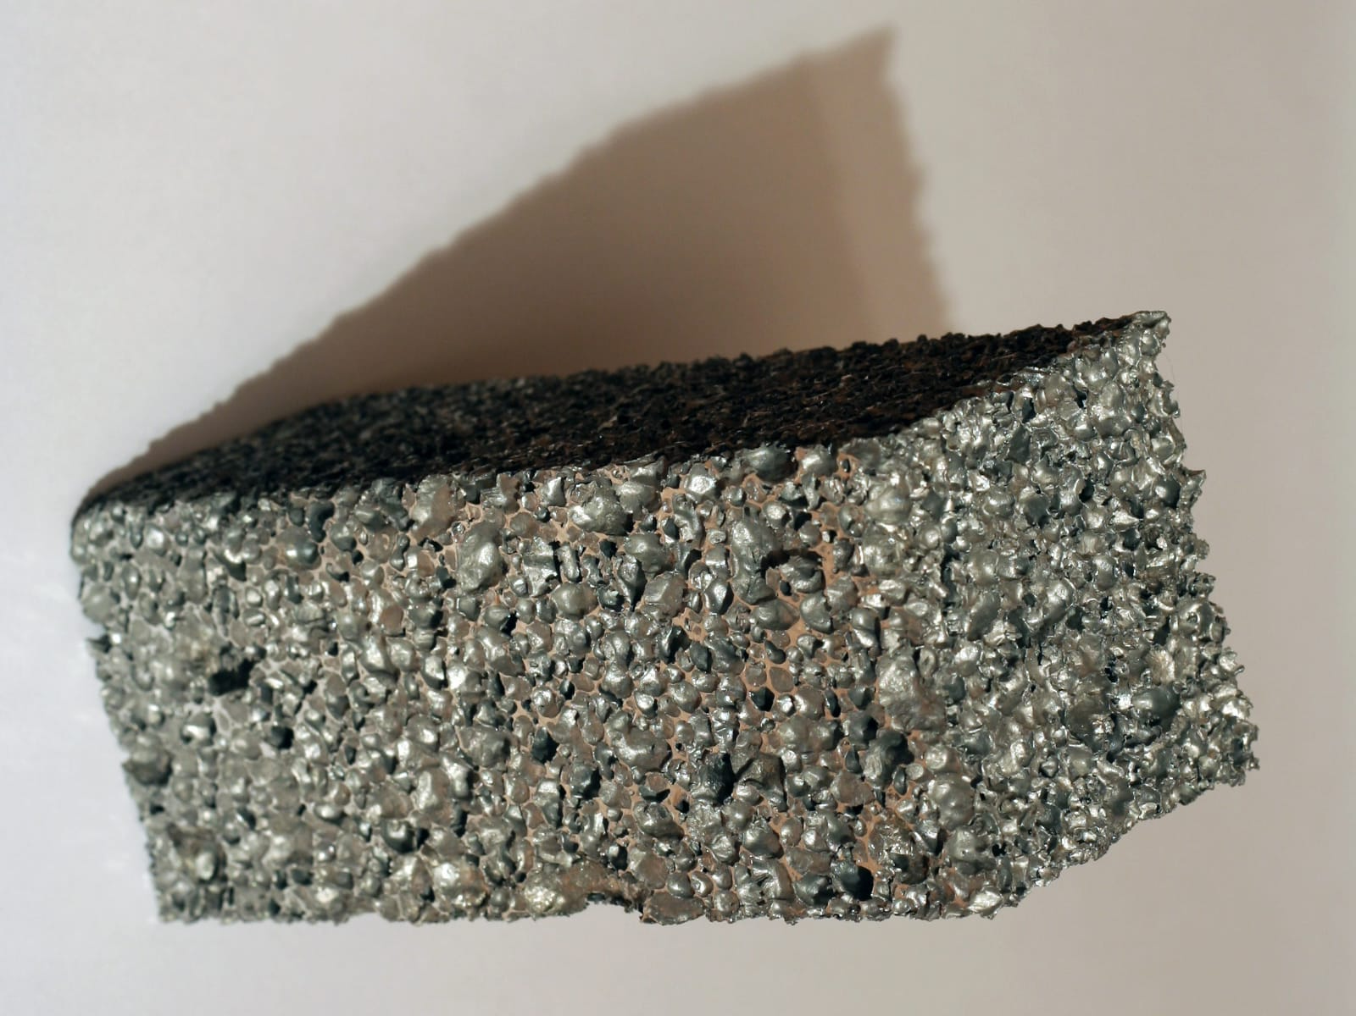
Metallic Foam
Upon learning the usefulness of metal foams, we started to study more about them and their making as well as properties. These are a new class of materials with low densities and novel physical, mechanical, thermal, electrical and acoustic properties. Which offer potential for lightweight structures, for energy absorption, and for thermal management; and some of them, at least, are cheap.
Metallic foams also offers significant performance gains in light, stiff structures, for the efficient absorption of energy, for thermal management.
Source :
Metalfoam/Wikimedia Commons

Slide 5
Why Use Metallic Foams ?
During an impact , metallic foams deform in such a way that they increase the total time of energy dispersion and thus reducing the resulting forces on the body.
They are very light (low density) in comparison to their respective metals.
The cost of production of metallic foam is relatively low.

Slide 6
Composition of aluminium alloy foam and Graphene reinforcement.
We use Aluminium LM13 alloy which has a constant 3 %wt Boron Carbide (B4C) prepared through stir casting.
Furthermore, the foam consist of 0.5%wt graphene reinforcement and is prepared through “Gas release in the melt” technique ,using CaCO3 as the foaming agent
Varying composition of graphene have been studied which give varying results on the size of plateau region during an impact , that was maximum for 0.62 %wt while showed minimum results for 0.4 %wt of graphene.However a graphene added hybrid foam always exhibits better energy absorption and plateau stress than the one without graphene.

Slide 7
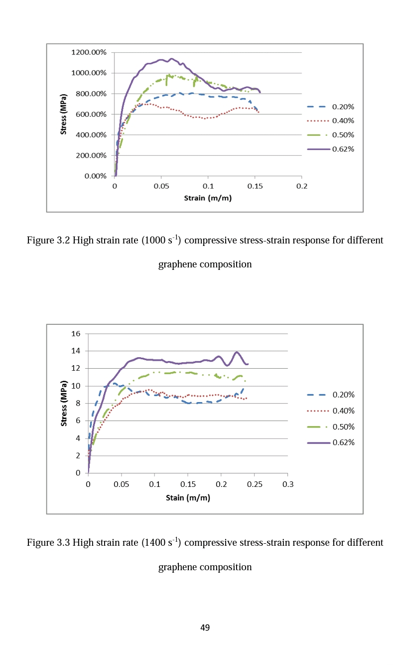
Effect of graphene reinforcement
Source Article: thesis by amitananad sinha at university of missouri coloumbia

Slide 8
Making of metallic foams
The properties of metal foams depend upon the properties of the metal, the relative density,cell size and cell topology (e.g. open or closed cell, cell size, etc.).
There are few distinct process-routes that have been developed to make metal foams in the industry of which we will be taking a look into the process that we have chosen to adapt.

Slide 9
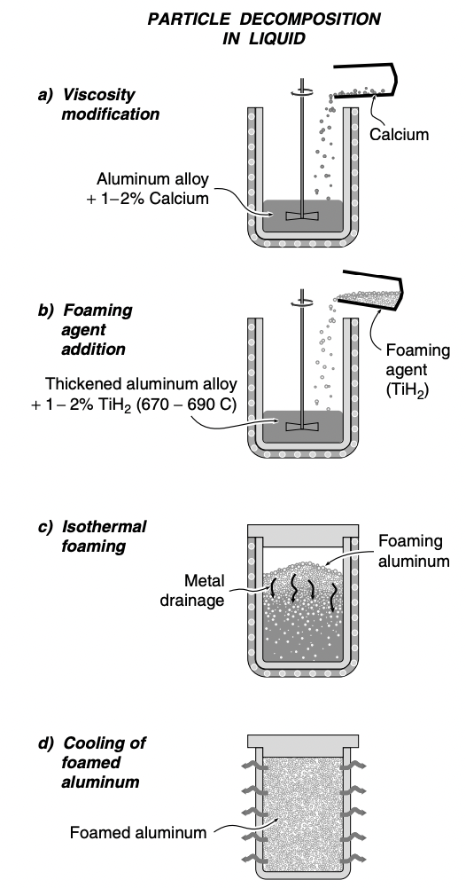
Gas-releasing particle decomposition in the melt
Metal alloys are foamed by mixing the metal into a foaming agent that releases gas when heated.
The process begins by melting aluminum and stabilizing the melt temperature between 670°C and 690°C stirring at about 700 rpm. Its viscosity is then raised by adding 1–2% of calcium which rapidly oxidizes and forms finely dispersed CaO and CaAl2O4 particles.
As soon as these are dispersed in the melt, the stirring system is withdrawn, and a foam is allowed to form above the melt under controlled environment by adjusting the pressure, temperature and time of foaming.
The process steps used in the manufacture of aluminum foams by gas-releasing particle decomposition in the melt (Alporas process)
Source Article: N A Endut et al 2018 IOP Conf. Ser.: Mater. Sci. Eng. 290 012084

Slide 10
Properties of metal foams
The characteristics of a foam are best summarized by describing the material from which it is made, its relative density, and stating whether it has open or closed cells. Beyond this, foam properties are influenced by structure, particularly by anisotropy and by defects – by which we mean buckled or broken cell walls, and cells of exceptional size or shape.

Slide 11
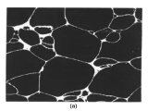
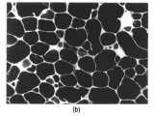
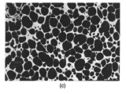
Foam structure
The structures are very like those of soap films: polyhedral cells with thin cell faces bordered by thicker cell edges (‘Plateau borders’). Some of the features appear to be governed by surface energy, as they are in soap films: the Plateau borders are an example. But others are not: many faces have non-uniform curvature or are corrugated, and have occasional broken walls that still hang in place.
The three figures are ordered such that the relative density increases from the top to the bottom.

Slide 12
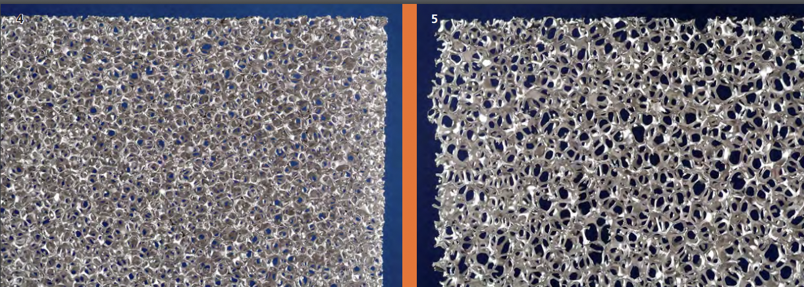
Open cell metallic foam structure
Open cell foams are permeable materials with metallic properties. They feature a very homogeneous structure which guarantees constant characteristics over a wide range.
Open-cell metal foams can be produced in a large spectrum of pore sizes and densities. The adjustable pore sizes range from 0.3 to 5 mm, the relative density can vary between 5 and 30 %. Because of the structure‘s high variability, the functional properties like mechanical strength, sound absorption, fluid and heat transfer can be precisely adjusted. With this, functional materials with an enormous application range arise.

Slide 13
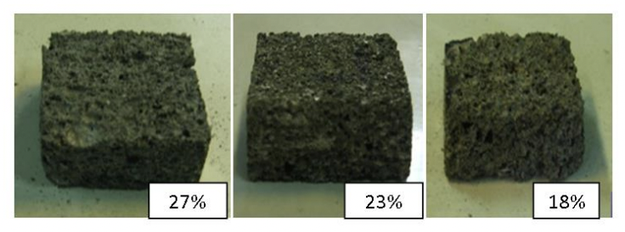
Closed cell metallic foam structure
Closed-cell metal foams are primarily used as an impact-absorbing material, similarly to the polymer foams in a bicycle helmet but for higher impact loads. Unlike many polymer foams, metal foams remain deformed after impact and can therefore only be deformed once. They are typically 10–25% of the density of an identical non-porous alloy; commonly those of aluminium and are frequently proposed as a lightweight structural material. However, they have not been widely used for this purpose.
Closed-cell foams retain the fire resistance and recycling potential of other metal foams, but add the property of flotation in water
Samples of Aluminum Foams with different relative densities.

Slide 14
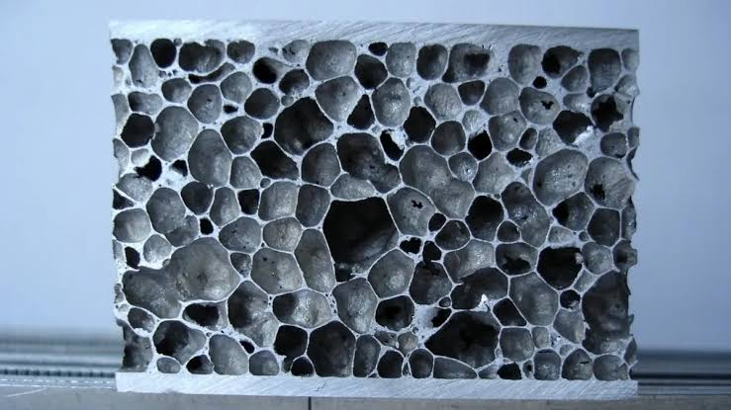
Aluminium Foam Sandwich
One of the excellent metal foam that are used by previous researchers is aluminium foam sandwich due to their unique properties such as low density, good energy absorption characteristics. Aluminium foam sandwich panels provide wide range of potential applications.
The sandwich panel structures is composed of a aluminum foam core and metal surfaces which is light weight and has high performance in dispersing energy. This has led to their widespread use in the absorption of energy. The cell structure of foam core is subjected to plastic deformation in the constant tension level that absorbs a lot of kinetic energy before destruction of the structure.

Slide 15
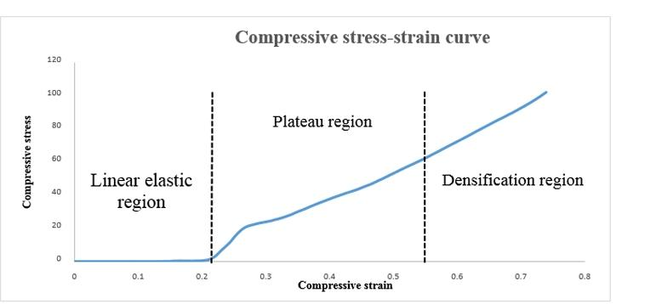
Compressive stress - strain curve for an ideal foam
For the first region, it refers to collapse stress, whereas for the plateau region, total deformation energy is absorbed at constant stress value. The final region which is densification region related to increasing of stress at constant strain value. At this region, the cell walls are in close contact each other.
Source Article: N A Endut et al 2018 IOP Conf. Ser.: Mater. Sci. Eng. 290 012084

Slide 16
Uniaxial compression test
A typical uniaxial compression stress–strain curve for an aluminum foam is shown. The slope of the initial loading portion of the curve is lower than that of the unloading curve. Surface strain measurements indicate that there is localized plasticity in the specimen at stresses well below the compressive strength of the foam, reducing the slope of the loading curve. As a result, measurements of Young’s modulus should be

Slide 17
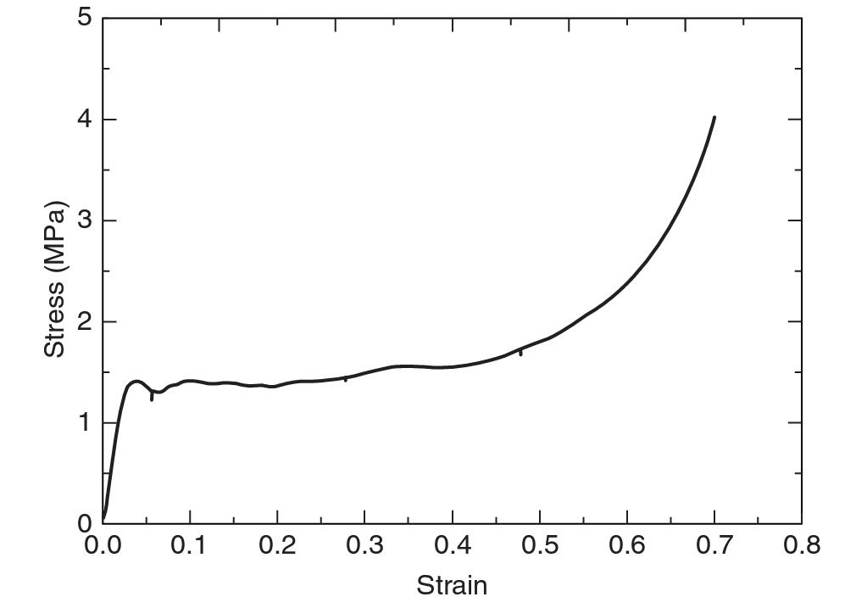
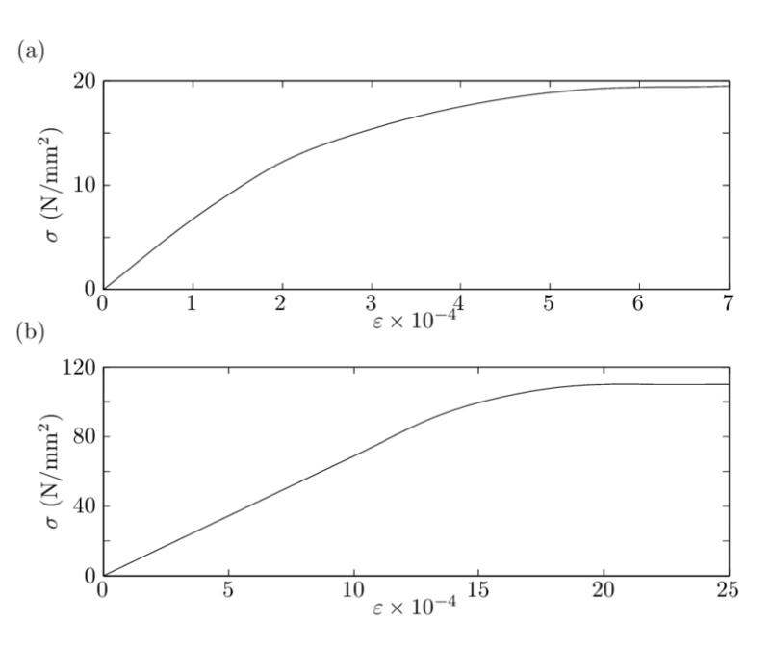
Stress strain curve of Aluminium Foams and Aluminium
Stress-strain curves for Aluminium Foam Sandwich.
Stress-strain curves for (a) pure aluminium and (b) aluminium alloy.Linear elasticity is valid up to (a) σ Lin = 8 N/mm 2 for pure aluminium and (b) σ Lin = 95 N/mm 2 for aluminium alloy.
Source Article:
N A Endut et al 2018 IOP Conf. Ser.: Mater. Sci. Eng. 290 012084
Experimental Evaluation of Interactive Buckle Localization in Compression Sandwich Panels
JO - Journal of Sandwich Structures & Materials

Slide 18
CONCLUSION
We learnt the following things throughout research tilll now:-
Why do we use metal foams instead of conventional metal sheets
What are aluminium foam sandwich and their compositional and structural analysis.
Effect of graphene reinforcement on the energy absorption.
Manufacturing method of aluminium foams
Different structures of aluminium foams
Study of compressive stress-strain curve compressive behaviour of aluminium foam upon impact.

